Slide 1

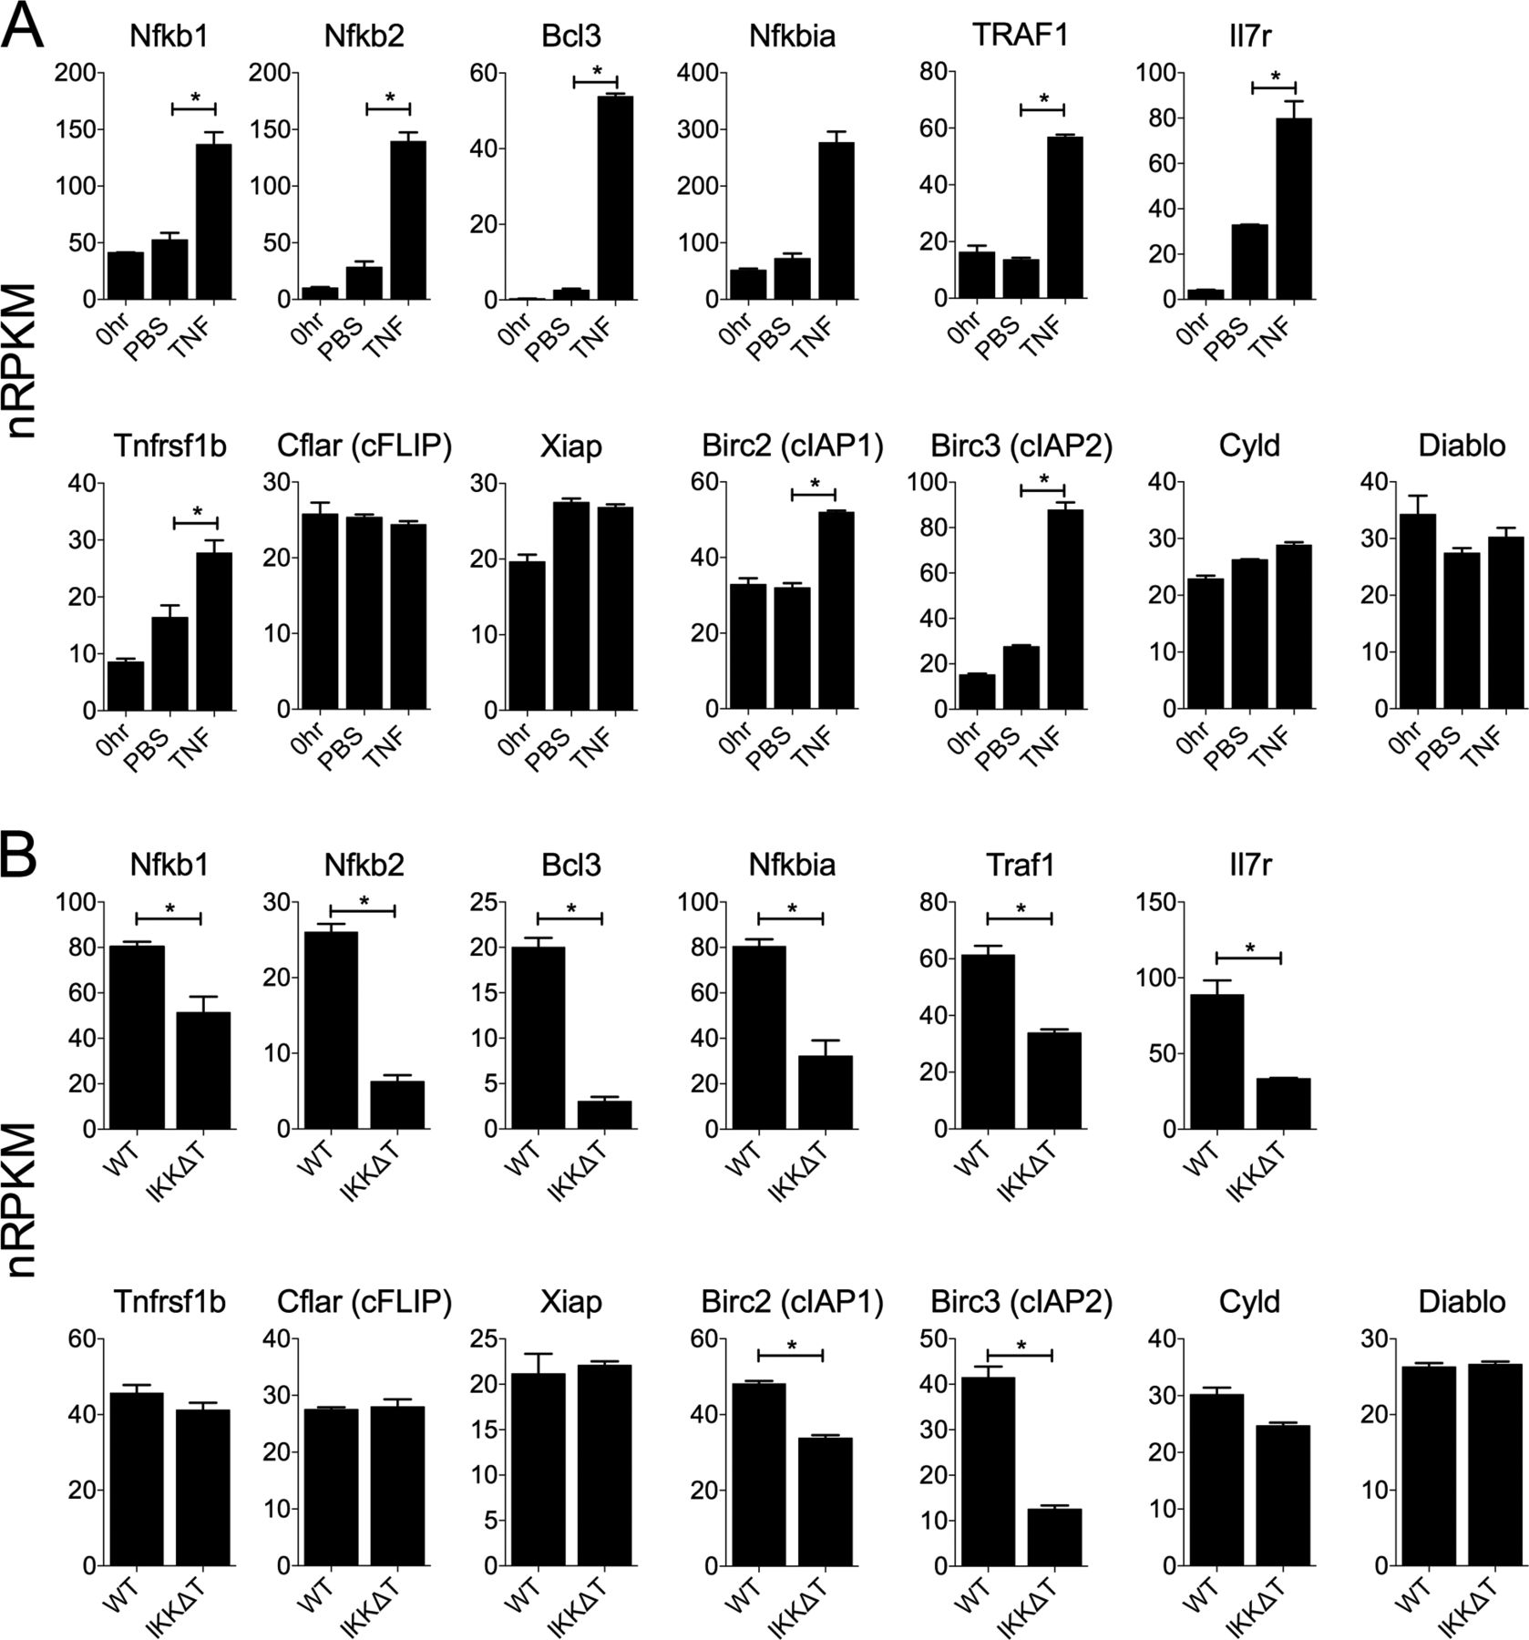
From: TNF activation of NF-κB is essential for development of single-positive thymocytes
J Exp Med. 2016;213(8):1399-1407. doi:10.1084/jem.20151604
Figure Legend:
cIAP1 and cIAP2 expression is induced by TNF in vitro and is NF-κB dependent in vivo. (A) TCR^{hi} CD8SP thymocytes from F5 Rag1^{−/−} donors were sort purified and stimulated with TNF (n = 4) or PBS (n = 4) as control. mRNA was isolated from cultured and uncultured cells (0 h, n = 3) and gene expression determined by RNAseq analysis. Bar charts show mRNA expression level (normalized reads per kb exons per million reads, nRPKM) of the indicated genes. Names in brackets indicate protein name associated with gene. (B) TCR^{hi} CD8SP thymocytes were sorted from WT (n = 3) and Tnfrsf1a^{−/−} IKKΔT^{CD4} mice (n = 4). mRNA was purified and gene expression was determined by RNAseq analysis. Bar charts show mRNA expression level (nRPKM) of the indicated genes. Individual RNAseq libraries were generated from independent cell preparation and treatments. *, P < 0.05.
Copyright © 2024 Rockefeller University Press

Slide 2
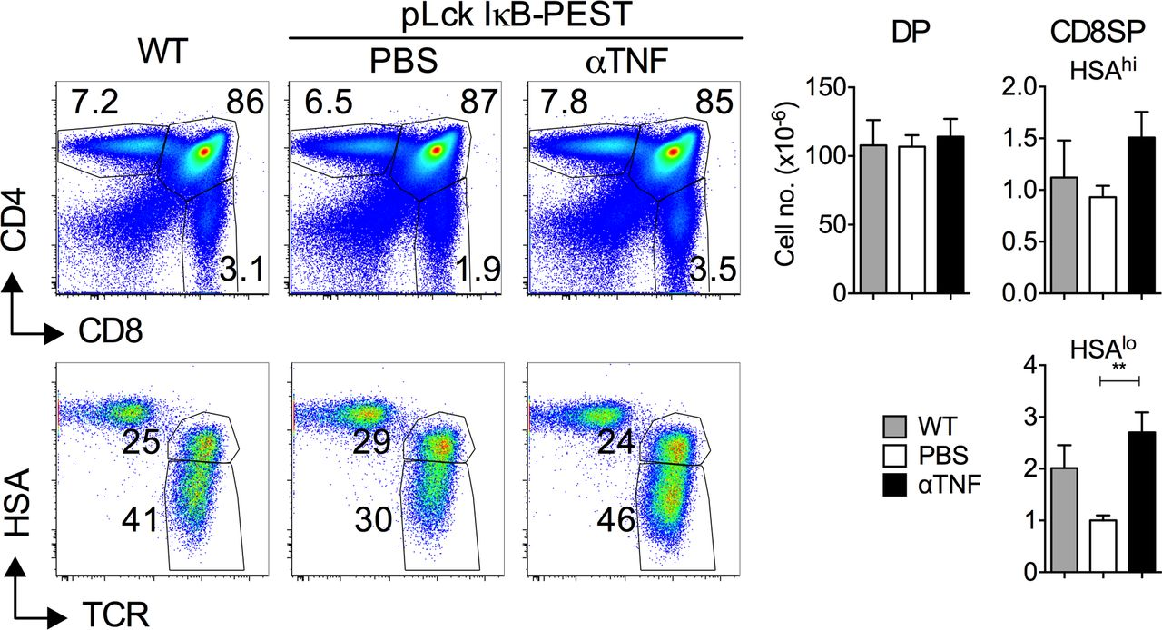
From: TNF activation of NF-κB is essential for development of single-positive thymocytes
J Exp Med. 2016;213(8):1399-1407. doi:10.1084/jem.20151604
Figure Legend:
TNF blockade rescues the developmental block in pLck IκB-PEST mice. pLck IκB-PEST mice were treated with anti-TNF (n = 8; 1 mg, days 0, 2, and 4) or PBS (n = 8) injection as control. At day 7, thymi were analyzed by FACS. Density plots are of CD4 versus CD8 by total live (top row) and HSA versus TCR by CD8SP gated thymocytes from pLck IκB-PEST mice treated with either anti-TNF (αTNF) or PBS as control. Transgene -ve (WT, n = 4) littermates were also analyzed as control. Bar charts show total cell numbers of the indicated thymocyte subset recovered from the indicated treatment groups. Data are pooled from two independent experiments. **, P < 0.01.
Copyright © 2024 Rockefeller University Press

Slide 3
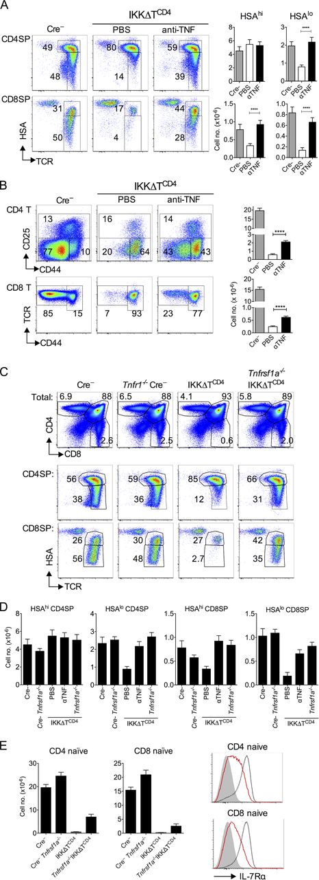
From: TNF activation of NF-κB is essential for development of single-positive thymocytes
J Exp Med. 2016;213(8):1399-1407. doi:10.1084/jem.20151604
Figure Legend:
TNF blockade rescues SP development in IKKΔT^{CD4} mice. (A and B) Ikk1^{fx/fx} Ikk2^{fx/fx} R26^{REYFP} CD4^{Cre} (IKKΔT^{CD4}) mice (8–16 wk old) were treated with anti-TNF mAb i.p. (1 mg/inject; n = 16) or PBS as control (n = 17). After 7 d, thymus and lymph node cells were analyzed by FACS. (A) Density plots are of TCR versus HSA expression by CD4SP (top row) and CD8 SP (bottom row) from IKKΔT^{CD4} mice treated with anti-TNF or PBS as compared with untreated Cre -ve littermate controls (Cre–, n = 17). Bar charts show total cell recoveries of HSA^{hi} and HSA^{lo} cells among CD4SP (top row) and CD8SP (bottom row). (B) Density plots are of CD44 versus CD25 by CD4⁺TCR^{hi} T cells (top row) and CD44 versus TCR by CD8⁺ cells from lymph nodes of the same treatment groups described in A. Bar charts show cell numbers of naive CD4 (top chart) and naive CD8 (bottom chart) T cells from mice. (C) Density plots are of CD4 versus CD8 by total live thymocytes (top row), and TCR versus HSA by CD4SP (middle row) and CD8SP thymocytes (bottom row) from IKKΔT^{CD4} mice, Cre -ve littermate controls (Cre–), Tnfrsf1a^{−/−} IKKΔT^{CD4} mice (n = 16), and Cre -ve littermate controls (Tnfrsf1a^{−/−} Cre–, n = 13). (D) Bar charts show cell numbers of the indicated SP subset recovered from IKKΔT^{CD4} mice treated with anti-TNF (αTNF) or PBS as described in A, untreated Cre -ve littermates (Cre–), or Tnfrsf1a^{−/−} IKKΔT^{CD4} mice and Cre -ve littermate controls (Tnfrsf1a^{−/−} Cre–). (E) Bar charts show total numbers of naive CD44^{lo} CD25– CD4⁺ TCR^{hi} T cells and naive CD44^{lo} CD8⁺ TCR^{hi} T cells from lymph nodes of Ikk1^{fx/fx} Ikk2^{fx/fx} R26^{REYFP} CD4^{Cre} (IKKΔT^{CD4}, n = 17) mice, Cre -ve littermates (Cre–, n = 17), Tnfrsf1a^{−/−} IKKΔT^{CD4} mice (n = 16), and Cre -ve littermate (Cre– Tnfrsf1a^{−/−}, n = 13) as control. Histograms are of IL-7Rα by gated naive CD44^{lo} CD25– CD4⁺ TCR^{hi} T cells (top) and naive CD44^{lo} CD8⁺ TCR^{hi} T cells (bottom) from WT (black broken lines), Tnfrsf1a^{−/−} IKKΔT^{CD4} mice (red solid lines) and Cre -ve Tnfrsf1a^{−/−} littermates (solid line). Gray fills are IL-7Rα expression by DP thymocytes from WT mice as negative control. FACS data are representative of four or more independent experiments, and bar charts are pooled from four or more independent experiments. ****, P < 0.0001.
Copyright © 2024 Rockefeller University Press

Slide 4
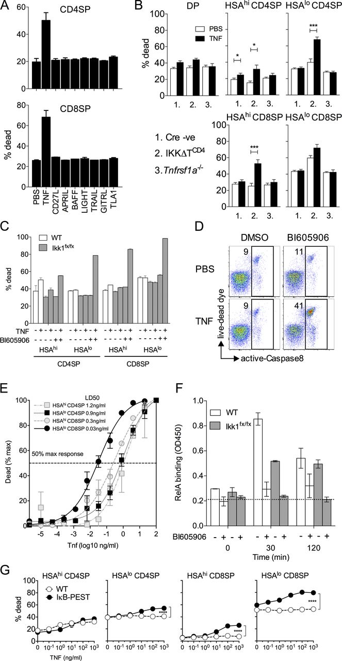
From: TNF activation of NF-κB is essential for development of single-positive thymocytes
J Exp Med. 2016;213(8):1399-1407. doi:10.1084/jem.20151604
Figure Legend:
TNF induces thymocyte cell death in the absence of IKK activity in vitro. (A) Thymocytes from Ikk1^{fx/fx} Ikk2^{fx/fx} R26^{REYFP} CD4^{Cre} (IKKΔT^{CD4}) mice were cultured overnight with the indicated Tnfrsf member, and viability of the indicated SP subset assessed the next day by FACS. (B) Thymocytes from IKKΔT^{CD4}, Cre -ve littermates (Cre -ve), and Tnfrsf1a^{−/−} donors were cultured overnight with and without TNF (30 ng/ml). Bar chart shows viability among the indicated subsets cultured with addition of PBS (open bars) or TNF (filled bars) as assessed by FACS. (C) Thymocytes from WT and Ikk1^{fx/fx} R26^{REYFP} huCD2^{iCre} donors were cultured overnight in the presence of TNF or IKK2 inhibitor Bl605906, or both. Bar chart shows percentage of viability among the indicated subsets as assessed by FACS. (D) Ikk1^{fx/fx} R26^{REYFP} huCD2^{iCre} thymocytes were cultured for 4 h in the presence of TNF and/or IKK2 inhibitor Bl605906. Density plots are of live dead versus active caspase 8 stain by CD8 SP thymocytes. (E) Thymocytes from Ikk1^{fx/fx} R26^{REYFP} huCD2^{iCre} donors were cultured with IKK2 inhibitor and a titration of TNF. Line graph shows the percentage of maximum TNF-induced death for different concentrations of TNF, above background, for the indicated subsets. Concentrations in figure legend indicate LD₅₀ of TNF for the corresponding subset. (F) Thymocytes from WT or Ikk1^{fx/fx} R26^{REYFP} huCD2^{iCre} donors were pre-incubated with IKK2 inhibitor Bl605906 or DMSO vehicle for 1 h where indicated, and then stimulated with TNF and nuclear extracts prepared at different times. Bar charts represent RelA binding to NF-κB binding oligonuclotides as detected by ELISA and displayed as OD. Dotted line indicates the background signal from blank wells. (G) Thymocytes from pLck-IκB-PEST donors or transgene -ve littermates were cultured in different concentrations of TNF overnight. Line graphs are of percentage dead cells in the indicated subsets from pLck-IκB-PEST donors (IκB-PEST, filled circles) or transgene negative litter controls (WT, open circles). Error bars indicate SD of technical duplicates. Data are representative of two (F), three (G), or more (A–E) independent experiments. *, P < 0.05; ***, P < 0.001.
Copyright © 2024 Rockefeller University Press

Slide 5
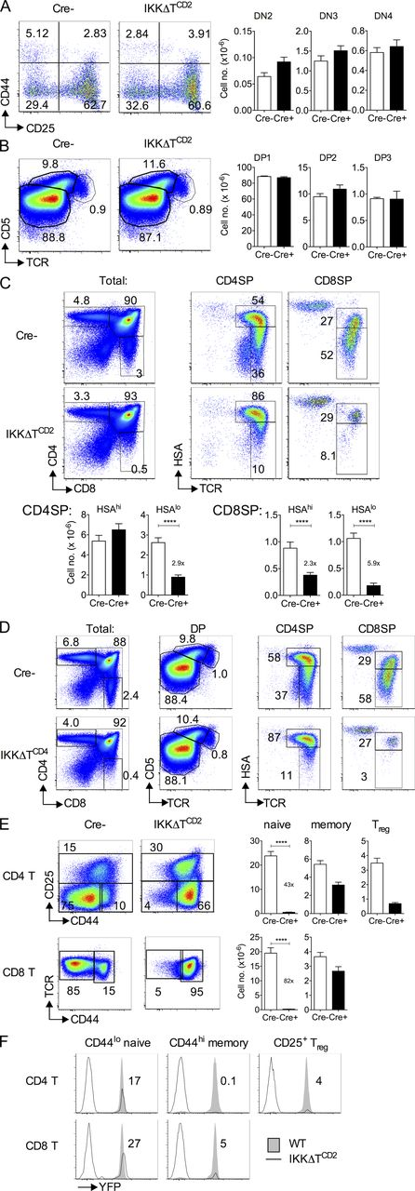
From: TNF activation of NF-κB is essential for development of single-positive thymocytes
J Exp Med. 2016;213(8):1399-1407. doi:10.1084/jem.20151604
Figure Legend:
Deletion of Ikk1 and Ikk2 blocks SP thymocyte development. Lymphoid organs from 8–12-wk-old Ikk1^{fx/fx} Ikk2^{fx/fx} R26^{REYFP} huCD2^{iCre} (IKKΔT^{CD2}, n = 16) were analyzed by FACS and compared with huCD2^{iCre} -ve (Cre⁻, n = 15) littermate as control. (A) Density plots are of CD44 versus CD25 by DN Lin⁻ (CD4, CD8, TCRαβ, and CD5) thymocytes. Numbers indicate percentage in the corresponding quadrant. Bar charts are cell number of CD44^{hi}CD25^{hi} (DN2), CD44^{lo}CD25^{hi} (DN3), and CD44^{lo} CD25^{lo} (DN4) DN thymocyte subsets. (B) Density plots are of TCR versus CD5. Numbers indicate percentage in the corresponding gate. Bar charts are cell number of CD5^{lo}TCR^{lo} (DP1), CD5^{hi}TCR^{int} (DP2), and CD5^{int}TCR^{hi} (DP3) DP subsets. (C) Density plots are of CD4 versus CD8 expression by total live thymocytes and TCR versus HSA by CD4SP and CD8SP gated thymocytes. Bar charts show numbers of the indicated SP subset from IKKΔT^{CD2} mice (Cre⁺) and huCD2^{iCre} -ve (Cre⁻) littermates. Numbers indicate fold difference in counts between Cre⁻ and Cre⁺. (D) Density plots are of CD4 versus CD8 expression by total live thymocytes, TCR versus CD5 by DP thymocytes, and TCR versus HSA by CD4SP and CD8SP gated thymocytes from IKKΔT^{CD4} mice or Cre⁻ littermates. (E) Density plots are CD25 versus CD44 by CD4⁺TCR^{hi} gated lymph node cells and CD44 versus TCR by CD8⁺TCR^{hi} gated lymph node cells from the indicated strains and show gates used to define naive (CD44^{lo} CD25⁻), memory (CD44^{hi} CD25⁻), and T reg (CD25⁺) cells among CD4⁺TCR^{hi} cells, and naive (CD44^{lo}) and memory (CD44^{hi}) among CD8⁺TCR^{hi} cells. Bar charts show total number of naive, memory, and T reg cells recovered from lymph node and spleen of IKKΔT^{CD2} mice (Cre⁺) and huCD2^{iCre} -ve (Cre⁻) littermates. Numbers indicate fold difference in naive cell counts between Cre⁻ and Cre⁺ hosts. (F) Histograms are of EYFP expression by naive, memory, and regulatory CD4⁺TCR^{hi} T cells and naive and memory CD8⁺TCR^{hi} T cells from IKKΔT^{CD2} mice and huCD2^{iCre} Ikk1^{fx/WT} Ikk2^{fx/WT} R26^{REYFP} littermate controls (WT). Numbers indicate percentage of IKKΔT^{CD2} cells (solid lines) expressing YFP. FACS data are representative of four or more experiments and cell number data are pooled from four experiments. ****, P < 0.0001.
Copyright © 2024 Rockefeller University Press

