Slide 1

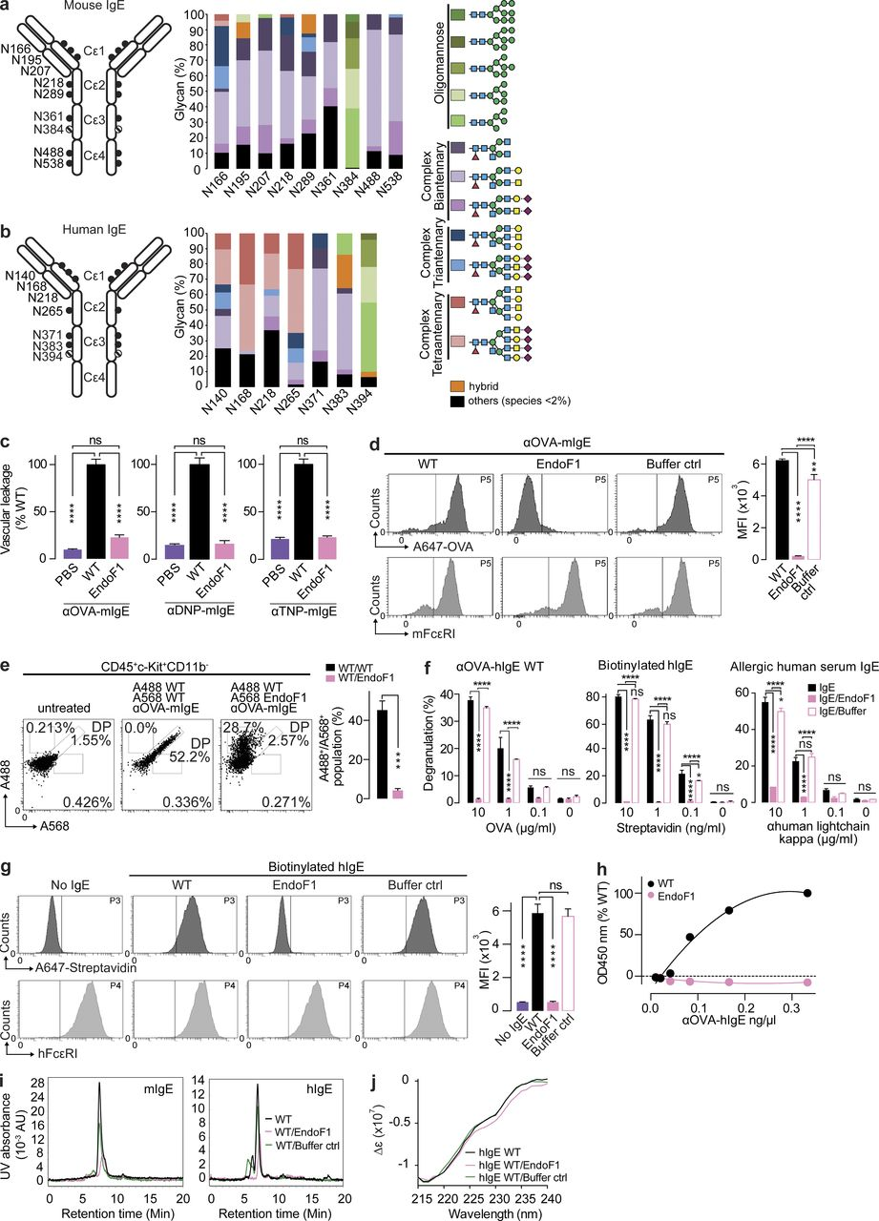
From: A single glycan on IgE is indispensable for initiation of anaphylaxis
J Exp Med. 2015;212(4):457-467. doi:10.1084/jem.20142182
Figure Legend:
Removal of the IgE oligomannose glycan abrogates anaphylaxis. (a and b) αOVA-mIgE (a) and αOVA-hIgE (b) schematics with N-linked glycosylation consensus sites are shown. Percentages of glycan structures identified by glycopeptide mass spectroscopy at each site are plotted. Glycans are composed of fucose (red), N-acetylglucosamine (GlcNAc; blue), mannose (green), galactose (yellow circles), N-acetylgalactosamine (GalNAc; yellow squares), and sialic acid (pink); representative of two experiments. (c) PCA quantified after PBS, WT, or EndoF1-mIgE specific for OVA, DNP, or TNP (n = 8; 2 independent experiments). (d) Histograms and MFI of WT-, EndoF1-, and EndoF1 buffer only–αOVA-mIgE bound to mBMMCs determined by A647-OVA and mFcεRI FACS (n = 3; 2 independent experiments). (e) Scatter plots of dermal mast cells recovered from ears injected with A488-WT- and A568-WT- or A488-WT- and A568-EndoF1-αOVA-mIgE (n = 2; 2 independent experiments). (f) β-Hexosaminidase activity after stimulation by OVA, streptavidin, or anti–human kappa light chain in LAD2 cells sensitized with αOVA-hIgE, biotinylated hIgE, or allergic human serum IgE or hIgE treated with EndoF1 or EndoF1 buffer only (n = 3; 2 independent experiments). (g) Binding of WT, EndoF1, or EndoF1 buffer only biotinylated hIgE to hFcεRI-HeLa cells as assessed by FACS (n = 3; 2 independent experiments). (h) Quantitation of WT or EndoF1-treated αOVA-hIgE bound to immobilized hFcεRIα (2 independent experiments). (i) Size exclusion chromatography profile of αOVA-mIgE or hIgE treated with EndoF1 or buffer only. (j) CD spectra of WT, EndoF1-treated, or EndoF1 buffer control hIgE (representative of two experiments). Mean and SEM are plotted; ****, P < 0.0001; ***, P < 0.001; **, P < 0.01; *, P < 0.05; ns, not significant.
Copyright © 2024 Rockefeller University Press

Slide 2
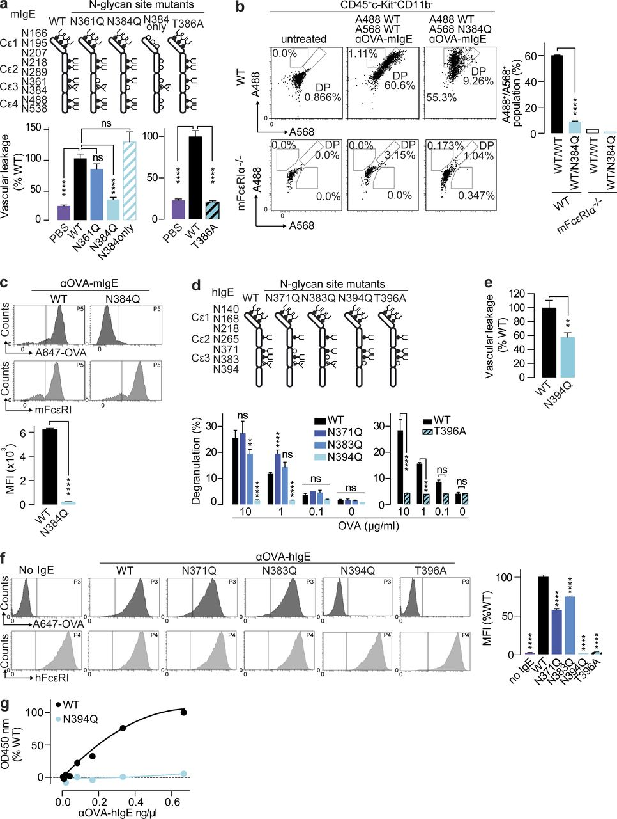
From: A single glycan on IgE is indispensable for initiation of anaphylaxis
J Exp Med. 2015;212(4):457-467. doi:10.1084/jem.20142182
Figure Legend:
A single N-linked glycosylation site is indispensable for anaphylaxis and hFcεRI binding. (a) Quantified OVA-induced PCA with PBS, WT, or αOVA-mIgE Cε3 domain glycomutants (n = 8; 3 independent experiments). (b) Scatter plots of CD45⁺c-Kit⁺CD11b⁻ mast cells recovered from WT or mFcεRI^{−/−} ears injected with A488-WT and A568-WT αOVA-mIgE or A488-WT and A568-N384Q αOVA-mIgE the previous day. Percentage of A488 and A568 double-positive mast cells are shown (n = 2; 2 independent experiments). (c) Histograms and MFI of WT or N384Q αOVA-mIgE binding to mBMMCs determined by A647-OVA and mFcεRI (n = 3; 2 independent experiments). (d) OVA-induced degranulation assayed by β-hexosaminidase in LAD2 cells sensitized with WT or αOVA-hIgE glycosylation mutants (n = 3; 4 independent experiments). (e) OVA-induced PCA vascular leakage in hFcεRI⁺/mFcεRI^{−/−} mice by PBS, WT, or N394Q αOVA-hIgE (n = 3; 2 independent experiments). (f) Binding of WT or αOVA-hIgE mutants to hFcεRI⁺-HeLa cells as assessed by A647-OVA (n = 2; 2 independent experiments). (g) Binding of increasing concentrations of WT or N394Q αOVA-hIgE to immobilized hFcεRIα in vitro (2 independent experiments.) Mean and SEM are plotted; ****, P < 0.0001; ***, P < 0.001; **, P < 0.01; ns, not significant.
Copyright © 2024 Rockefeller University Press

Slide 3
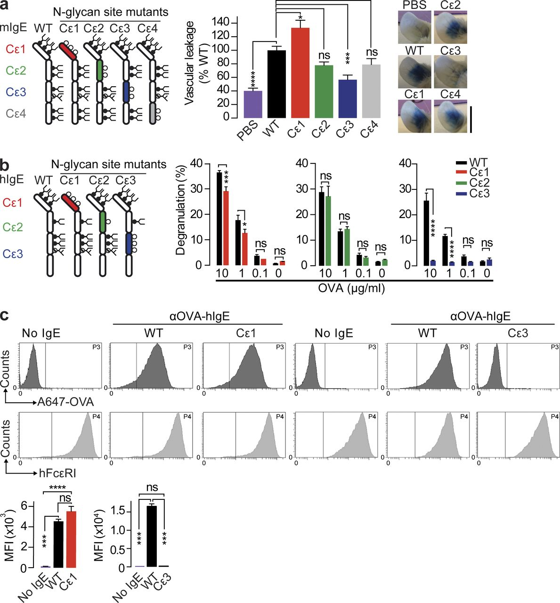
From: A single glycan on IgE is indispensable for initiation of anaphylaxis
J Exp Med. 2015;212(4):457-467. doi:10.1084/jem.20142182
Figure Legend:
Glycosylation of IgE Cε3 is required for anaphylaxis and FcεRI binding. (a) Quantified OVA-specific PCA by PBS, WT, or αOVA-mIgE domain mutants (n = 8; 3 independent experiments). Bar, 1 cm. (b) β-Hexosaminidase activity after OVA-induced degranulation in LAD2 cells sensitized with WT or αOVA-hIgE glycomutants (n = 3; 3 independent experiments). (c) WT-αOVA-hIgE or Cε1- and Cε3-αOVA-hIgE glycosylation mutant binding to hFcεRI⁺-HeLa cells assessed by A647-OVA and α-hFcεRI-PE FACS (n = 2; 2 independent experiments). Mean and SEM are plotted; ****, P < 0.0001; ***, P < 0.001; *, P < 0.05; ns, not significant.
Copyright © 2024 Rockefeller University Press

Slide 4
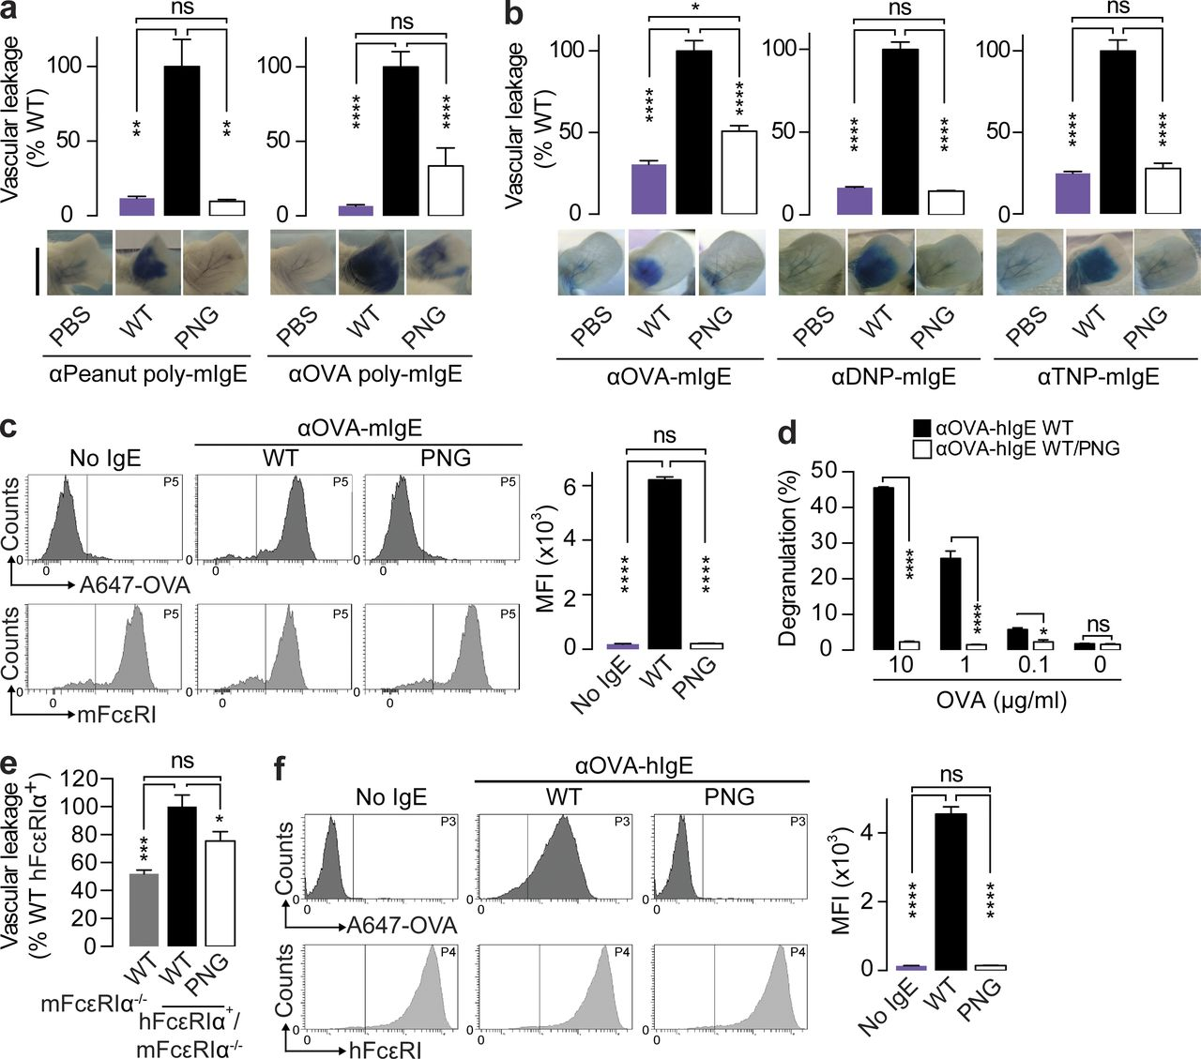
From: A single glycan on IgE is indispensable for initiation of anaphylaxis
J Exp Med. 2015;212(4):457-467. doi:10.1084/jem.20142182
Figure Legend:
N-linked glycosylation is essential for IgE-mediated allergic inflammation. (a and b) Quantified vascular leakage and representative ear images after PCA with PBS, WT, or PNG–poly-mIgE specific for OVA or peanut extracts (n = 4 ears; 2 independent experiments; a) or monoclonal mIgE specific for OVA, DNP, or TNP (n = 8; 2, 3, and 3 independent experiments for OVA, DNP, and TNP; b). Bar, 1 cm. (c) Histograms and mean fluorescent intensity (MFI) of WT or PNG-αOVA-mIgE binding to mBMMCs determined by A647-OVA and mFcεRI (n = 3; 2 independent experiments). (d) β-Hexosaminidase activity after OVA stimulation of LAD2 cell sensitized with WT or PNG-treated αOVA-hIgE (n = 3; 5 independent experiments). (e) Quantified OVA-induced PCA in mFcεRI^{−/−} or hFcεRI⁺mFcεRI^{−/−} mice sensitized by WT or PNG-αOVA-hIgE (n = 4; 2 independent experiments). (f) FACS of WT or PNG-αOVA-hIgE to hFcεRI⁺-HeLa cells assessed by A647-OVA and α-hFcεRI-PE (n = 2; 2 independent experiments). Means and SEM are plotted; ****, P < 0.0001; ***, P < 0.001; **, P < 0.01; *, P < 0.05; ns, not significant.
Copyright © 2024 Rockefeller University Press

