Slide 1

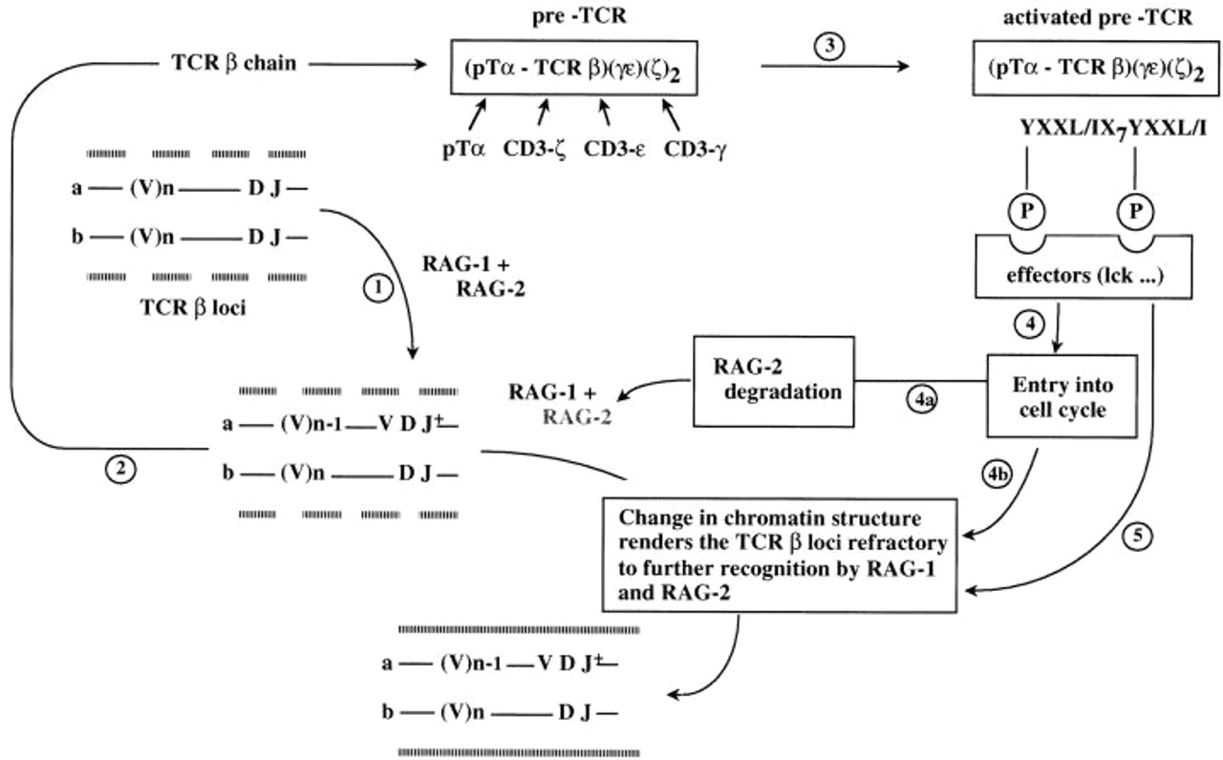
From: The CD3-γδε and CD3-ζ/η Modules Are Each Essential for Allelic Exclusion at the T Cell Receptor β Locus but Are Both Dispensable for the Initiation of V to (D)J Recombination at the T Cell Receptor–β, –γ, and –δ Loci
J Exp Med. 1998;187(1):105-116. doi:10.1084/jem.187.1.105
Figure Legend:
A model accounting for the role of the pre-TCR/ CD3 complex in the establishment of allelic exclusion at the TCR-β locus. Upon entering the CD44^{−/low} CD25⁺ compartment, the TCR Vβ gene segment cluster [(V)n] become accessible to the V(D)J recombinase (dashed lines sandwiching the TCR-β alleles a and b). At that stage of development, the pTα and CD3 components of the pre-TCR are already available and it is the TCR-β polypeptides that constitute the rate limiting factor in the assembly of the pre-TCR/CD3 complex. From a cohort of nine CD44^{−/low} CD25⁺ triple negative thymocytes, three are expected to produce a functional Vβ gene (VDJ⁺) as a result of their first attempt of rearrangement (step 1, see reference 29). The resulting TCR-β polypeptide participates in the assembly of a pre-TCR complex (step 2). As soon as assembled, this complex triggers (step 3) the transition beyond the CD44^{−/low} CD25⁺ stage and activates a negative feedback loop that will close the accessibility of the second, partially rearranged, allele (allele b) to the V(D)J recombinase (continuous lines sandwiching the TCR-β alleles), thereby restricting such a T cell to the expression of only a single TCR-β chain allele. The p56^{lck} kinase (lck) constitutes one of the effector operating downstream of the pre-TCR/CD3 complex since the overexpression of a catalytically active form of p56^{lck} inhibits endogenous Vβ to DβJβ rearrangements while inducing coincidently the transition to the DP stage (30). As proposed previously (29), time delay along this negative feedback loop, and/or the existence of a few cells in which Vβ to DβJβ rearrangements can be attempted quasisimultaneously on both β alleles, may explain the presence of rare cells with two productively rearranged TCR-β alleles (52, 53). Based on the comparison of TCR-β transgenic, p56^{lck−/−}, and TCR-β transgenic, CD3-ζ/η^{−/−} mice (see Discussion), it is tempting to speculate that TCR-β gene allelic exclusion is brought about via two contingent pathways. One of which (step 4b), by inducing cell proliferation and DNA replication, enables the reprogrammation of the chromatin structure at the TCR-β locus, and thereby permits factor(s) induced by the second pathway (step 5) to act and render the TCR-β locus inaccessible to further V(D)J recombination. Note that the degradation of RAG-2, which results from cyclin-dependent kinase phosphorylation (loop 4a; reference 38) and occurs during the burst of divisions associated with the transition from the DN to the DP stage, appears to constitute a fail-safe mechanism not essential for the execution of TCR-β allelic exclusion (39).
Copyright © 2024 Rockefeller University Press

Slide 2
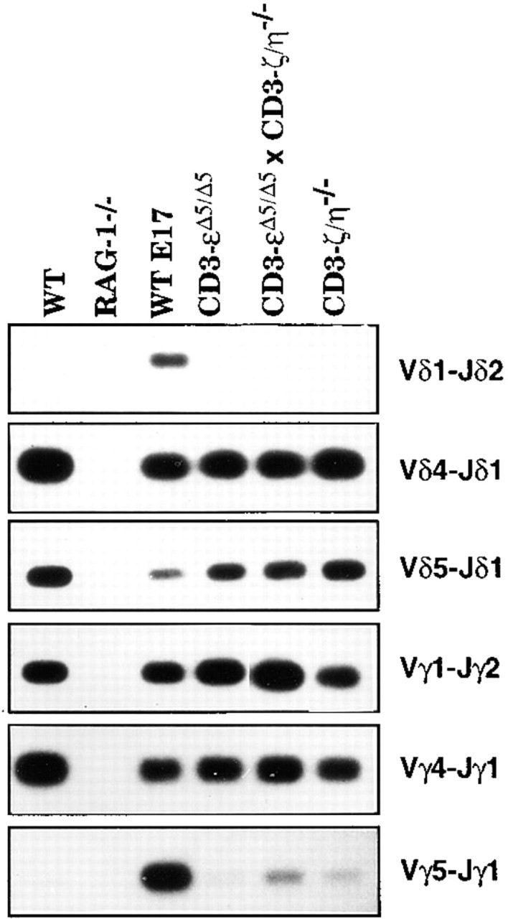
From: The CD3-γδε and CD3-ζ/η Modules Are Each Essential for Allelic Exclusion at the T Cell Receptor β Locus but Are Both Dispensable for the Initiation of V to (D)J Recombination at the T Cell Receptor–β, –γ, and –δ Loci
J Exp Med. 1998;187(1):105-116. doi:10.1084/jem.187.1.105
Figure Legend:
Relative levels of TCR-γ and TCR-δ gene rearrangements in RAG-1^{−/−}, CD3-ε^{Δ5/Δ5}, CD3-ζ/η^{−/−}, CD3-ε^{Δ5/Δ5}, CD3-ζ/η^{−/−}, and wild-type thymocytes. DNA extracted from thymocytes of fetuses at day 17 of gestation (wt E17) and of 4–6-wk-old wild-type (WT) and mutant mice was amplified with PCR primer pairs specific for the Vδ1–Jδ2, Vδ4– Jδ1, Vδ5–Jδ1, Vγ5–Jγ1, Vγ4–Jγ1, and Vγ1–Jγ2 rearrangements. PCR products were gel fractionated and the corresponding Southern blots hybridized with labeled oligonucleotide probes.
Copyright © 2024 Rockefeller University Press

Slide 3
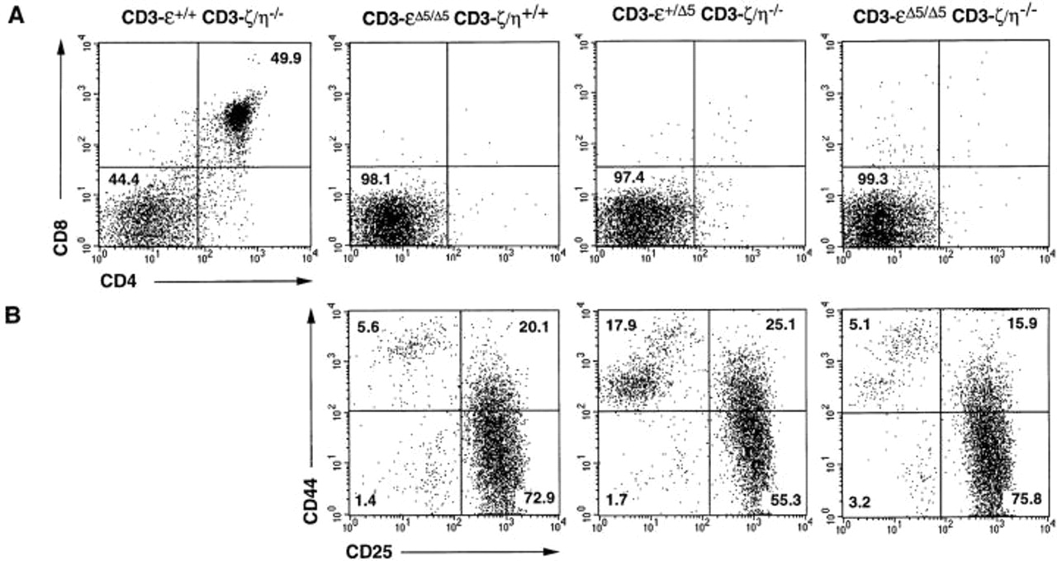
From: The CD3-γδε and CD3-ζ/η Modules Are Each Essential for Allelic Exclusion at the T Cell Receptor β Locus but Are Both Dispensable for the Initiation of V to (D)J Recombination at the T Cell Receptor–β, –γ, and –δ Loci
J Exp Med. 1998;187(1):105-116. doi:10.1084/jem.187.1.105
Figure Legend:
T cell development in CD3-ε^{Δ5/Δ5}CD3-ζ/η^{−/−} double mutant mice. Mice with ε^{Δ5/Δ5}ζ/η^{+/+}, ε^{+/+}ζ/η^{−/−}, ε^{+/Δ5} ζ/η^{−/−}, and ε^{Δ5/Δ5}ζ/η^{−/−} genotypes were derived from an F2 intercross between CD3-ε^{Δ5/Δ5} and CD3-ζ/η^{−/−} mutant mice. Total thymocytes were analyzed by flow cytometry for the expression of CD4 versus CD8 (A) and CD25 versus CD44 (B). The percentages of cells found in each quadrant is indicated.
Copyright © 2024 Rockefeller University Press

Slide 4
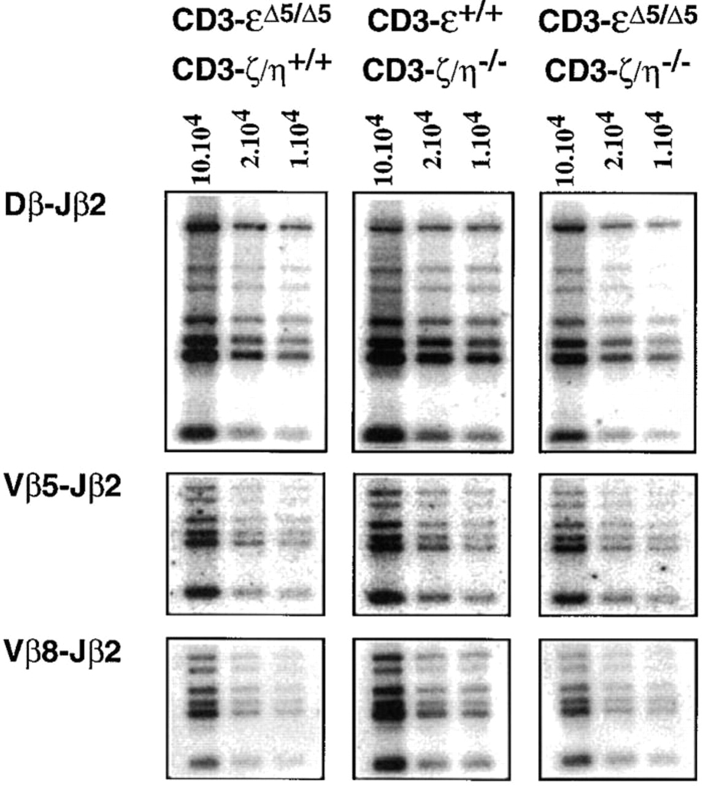
From: The CD3-γδε and CD3-ζ/η Modules Are Each Essential for Allelic Exclusion at the T Cell Receptor β Locus but Are Both Dispensable for the Initiation of V to (D)J Recombination at the T Cell Receptor–β, –γ, and –δ Loci
J Exp Med. 1998;187(1):105-116. doi:10.1084/jem.187.1.105
Figure Legend:
Vβ to DβJβ rearrangements are not affected in CD3-ε^{Δ5/Δ5} CD3-ζ/η^{−/−} double mutant mice. The relative levels of TCR-β rearrangements found in ε^{Δ5/Δ5}ζ/η^{+/+}, ε^{+/+}ζ/η^{−/−}, and ε^{Δ5/Δ5}ζ/η^{−/−} thymocytes were determined as described in the legend of Fig. 4.
Copyright © 2024 Rockefeller University Press

Slide 5
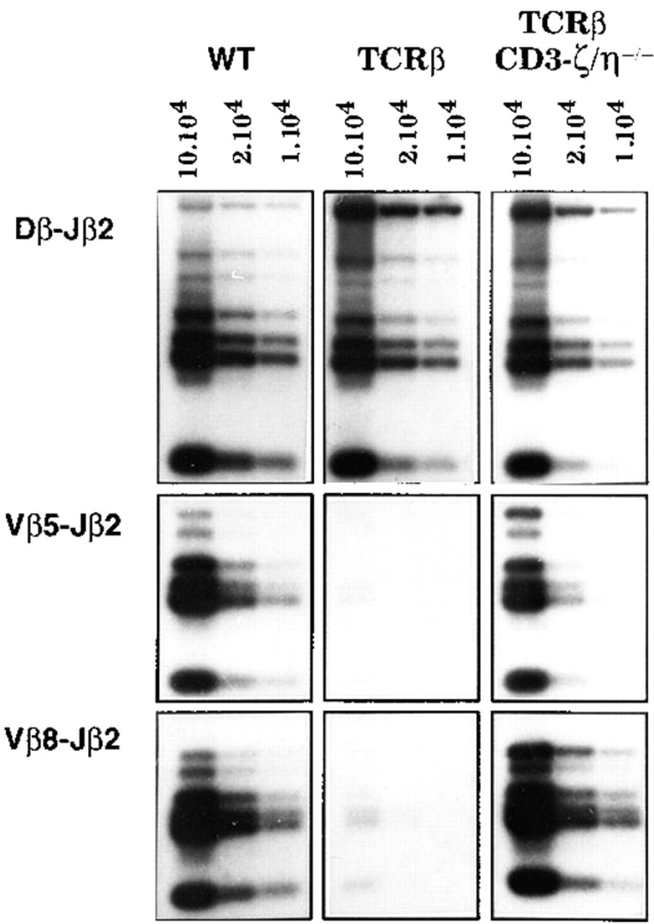
From: The CD3-γδε and CD3-ζ/η Modules Are Each Essential for Allelic Exclusion at the T Cell Receptor β Locus but Are Both Dispensable for the Initiation of V to (D)J Recombination at the T Cell Receptor–β, –γ, and –δ Loci
J Exp Med. 1998;187(1):105-116. doi:10.1084/jem.187.1.105
Figure Legend:
Expression of a transgenic TCR-β chain does not inhibit endogenous Vβ to DβJβ rearrangements in the absence of CD3-ζ/η polypeptide. The relative levels of TCR-β rearrangements found in CD3-ζ/η^{+/+} (WT), CD3-ζ/η^{+/+} TCR-β (TCRβ), and CD3-ζ/η^{−/−} TCR-β thymocytes were determined as described in the legend of Fig. 4.
Copyright © 2024 Rockefeller University Press

Slide 6
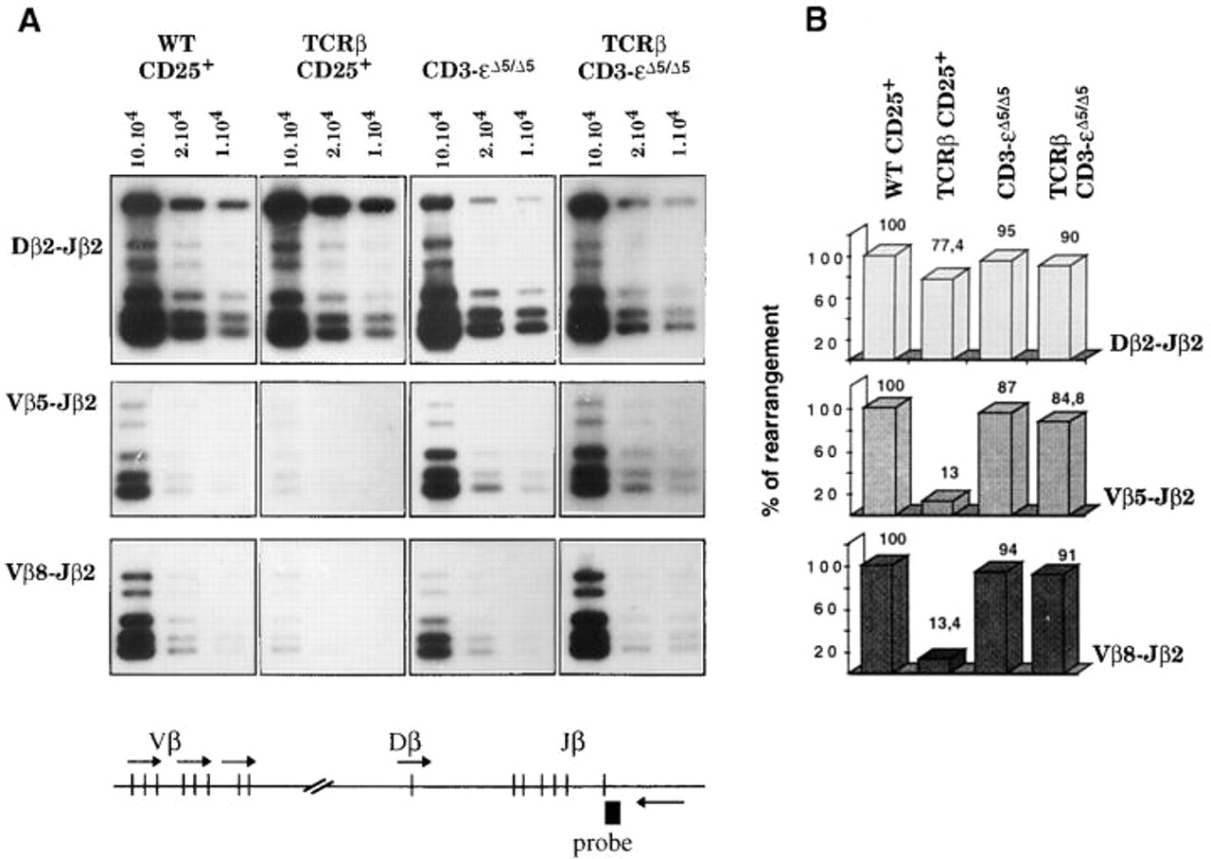
From: The CD3-γδε and CD3-ζ/η Modules Are Each Essential for Allelic Exclusion at the T Cell Receptor β Locus but Are Both Dispensable for the Initiation of V to (D)J Recombination at the T Cell Receptor–β, –γ, and –δ Loci
J Exp Med. 1998;187(1):105-116. doi:10.1084/jem.187.1.105
Figure Legend:
Expression of a transgenic TCR-β chain does not inhibit endogenous Vβ to DβJβ rearrangements in the absence of CD3-ε polypeptide. (A) Relative levels of TCR-β rearrangements in CD25⁺ cells sorted from CD3-ε^{+/+} (WT CD25⁺) and CD3-ε^{+/+} TCR-β (TCRβ CD25⁺) thymuses, and total thymocytes from CD3-ε^{Δ5/Δ5} and CD3-ε^{Δ5/Δ5} TCR-β mice. Identical sorting windows were set up on CD25^{high} DN cells for both the CD3-ε^{+/+} and CD3-ε^{+/+} TCR-β samples. Considering that they contain >90% CD44^{−/low}CD25^{high} DN cells (see Fig. 2), the CD3-ε^{Δ5/Δ5} and CD3-ε^{Δ5/Δ5} TCR-β thymuses were not subjected to sorting before analysis. The extent of Dβ–Jβ and Vβ–DβJβ rearrangements were analyzed by DNA-PCR. The relative positions of the PCR primers within the TCR-β locus are depicted by arrows in the bottom diagram. Products derived from PCR reactions involving the intronic Jβ2 3′ primer with Dβ2- (top), Vβ5- (middle) or Vβ8- (bottom) specific 5′ primers were gel fractionated and detected with the intronic probe depicted at the bottom (probe). Note that the cDNA-based P14 TCR-β transgene (Vβ8.1-Dβ-Jβ2.4) is not detectable with the pair of primers used to reveal endogenous Vβ8–Jβ2 rearrangements. For each sample, dilutions of DNA template corresponding to 1 × 10⁵, 2 × 10⁴, and 1 × 10⁴ cell equivalent were analyzed. (B) Quantification of the results shown in A. Hybridizing bands were scanned using a phosphorimager and the relative percentages of rearrangements compared to those present in CD25⁺ cells from CD3-ε^{+/+} (WT) mice.
Copyright © 2024 Rockefeller University Press

Slide 7
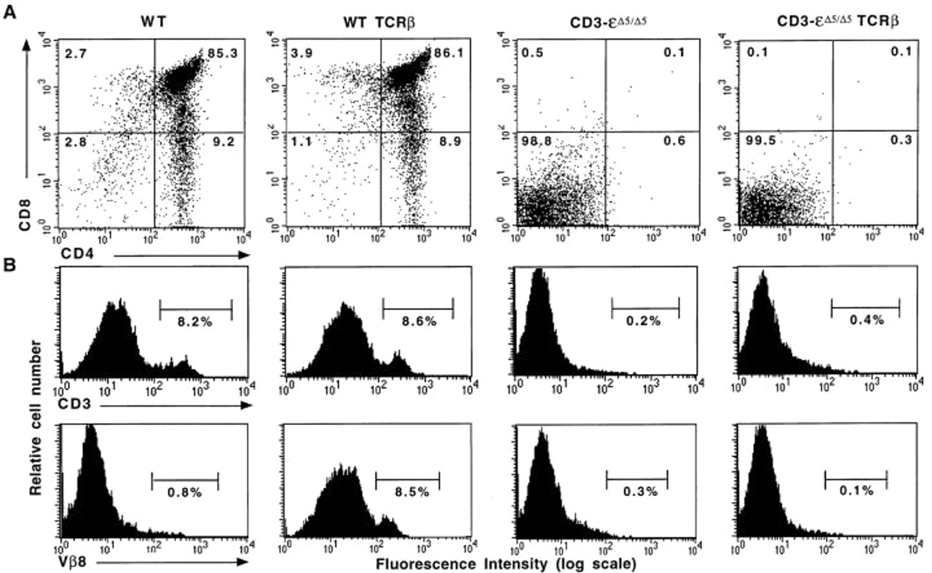
From: The CD3-γδε and CD3-ζ/η Modules Are Each Essential for Allelic Exclusion at the T Cell Receptor β Locus but Are Both Dispensable for the Initiation of V to (D)J Recombination at the T Cell Receptor–β, –γ, and –δ Loci
J Exp Med. 1998;187(1):105-116. doi:10.1084/jem.187.1.105
Figure Legend:
A transgene encoding a productively rearranged TCR-β gene does not restore T cell development in CD3-ε–deficient mice. Mice with CD3-ε^{+/+} (WT), CD3-ε^{+/+} TCR-β (WT TCR-β), CD3-ε^{Δ5/Δ5} and CD3-ε^{Δ5/Δ5} TCR-β genotypes were derived from a F2 intercross between the TCR-β transgenic line P14 TCR-β (TCR-β) and CD3-ε^{Δ5/Δ5} mutant mice. (A) Thymocytes were analyzed by flow cytometry for the expression of CD4 versus CD8. The percentage of cells found in each quadrant is indicated. (B) Thymocytes were analyzed for the expression of CD3-ε and Vβ8. Percentage of CD3^{high} and Vβ8^{high} cells are indicated. Considering that the exon coding for the epitope recognized by the 2C11 anti–CD3-ε antibody has been deleted in the CD3-ε^{Δ5} mutant gene, and that CD3-ε^{Δ5/Δ5} thymocytes do not express detectable levels of TCR-β chain at their surface (12), the histograms obtained after staining CD3-ε^{Δ5/Δ5} thymocytes with anti– CD3-ε or anti-Vβ8 antibodies were used as genuine negative control histograms. Note that in contrast to the situation previously observed in TCR-β transgenic SCID mice (50) and TCR-β transgenic RAG^{−/−} mice (51) where transgenic TCR-β chains are expressed as monomers without CD3-ε and in a phosphatidyl inositol-linked form, we have not been able to detect P14 TCR-β transgenic chains on the surface of CD3-ε^{Δ5/Δ5} TCR-β thymocytes after staining with the Cβ-specific antibody H57.597 (data not shown) and Vβ8-specific antibody F23.1 (compare the CD3-ε^{Δ5/Δ5} and CD3-ε^{Δ5/Δ5} TCR-β histograms). Whether such difference resulted from the use of the P14 TCR-β transgene or is rather due to the CD3-ε^{Δ5/Δ5} background remains to be determined.
Copyright © 2024 Rockefeller University Press

Slide 8
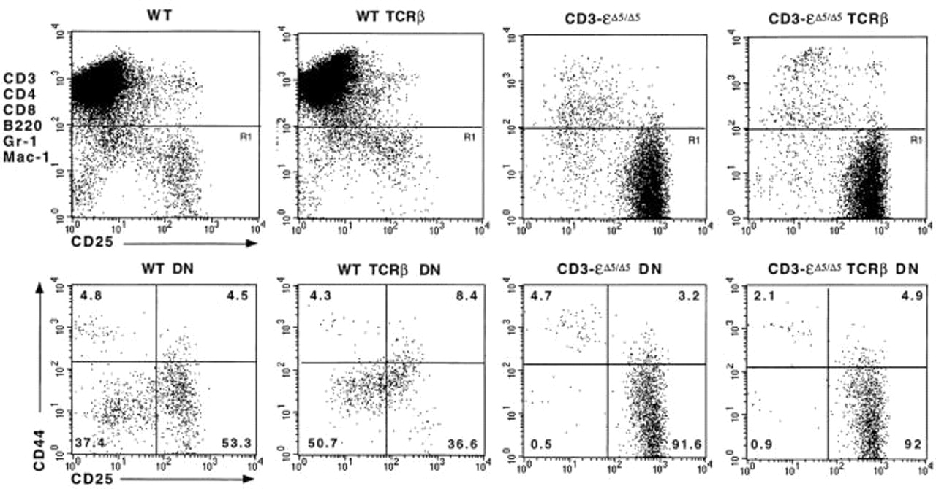
From: The CD3-γδε and CD3-ζ/η Modules Are Each Essential for Allelic Exclusion at the T Cell Receptor β Locus but Are Both Dispensable for the Initiation of V to (D)J Recombination at the T Cell Receptor–β, –γ, and –δ Loci
J Exp Med. 1998;187(1):105-116. doi:10.1084/jem.187.1.105
Figure Legend:
Comparison of the triple negative thymocyte subsets from wild type (WT) mice and CD3-ε^{Δ5/Δ5} mutant mice in the presence or absence of P14 TCR-β transgene (TCRβ). Thymocytes were stained with anti-CD3, -CD4, -CD8, -B220, -Mac-1, and Gr-1 (all biotinylated and detected with streptavidin tricolor), anti-CD44-PE, and anti-CD25-FITC. The position of the window (R1) used to identify the DN T lineage cells is shown in the top row for each type of mouse. In the bottom row, the DN T lineage cells were analyzed for the expression of CD25 and CD44. The percentage of cells found within each quadrant is indicated.
Copyright © 2024 Rockefeller University Press

Slide 9
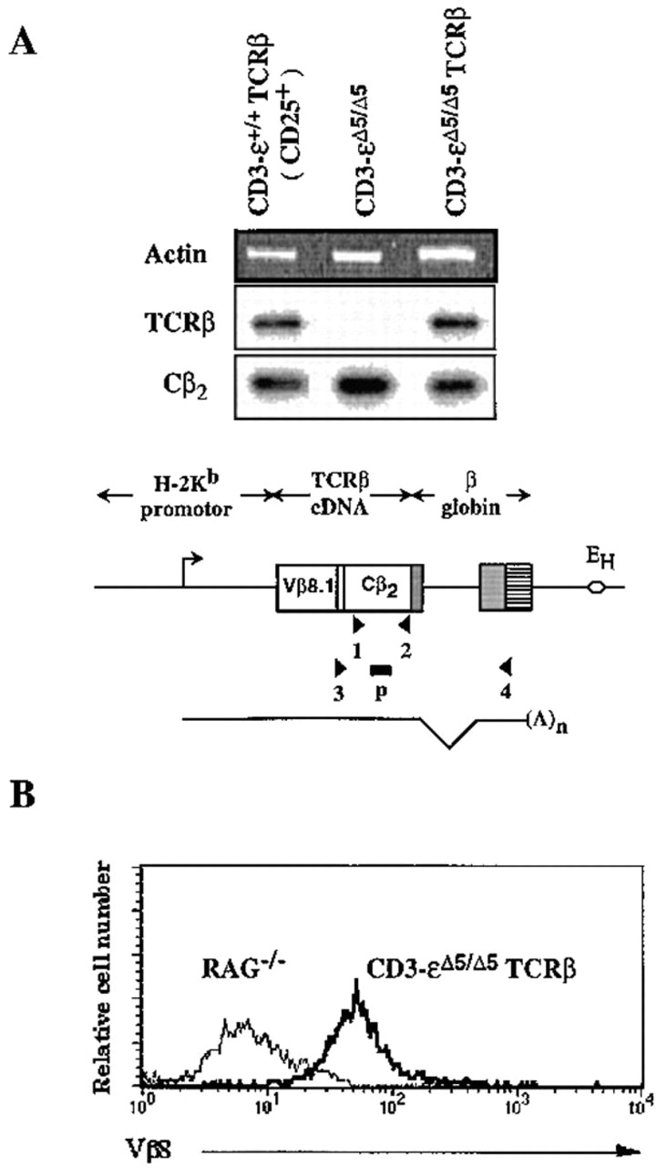
From: The CD3-γδε and CD3-ζ/η Modules Are Each Essential for Allelic Exclusion at the T Cell Receptor β Locus but Are Both Dispensable for the Initiation of V to (D)J Recombination at the T Cell Receptor–β, –γ, and –δ Loci
J Exp Med. 1998;187(1):105-116. doi:10.1084/jem.187.1.105
Figure Legend:
Assessment of TCR-β transgene expression by RNA-PCR and intracytoplasmic staining. (A) CD25⁺ cells sorted from TCR-β transgenic wild-type thymuses (CD3-ε^{+/+} TCR-β) and total thymocytes from TCR-β transgenic CD3-ε^{Δ5/Δ5} mice (CD3-ε^{Δ5/Δ5} TCR-β) were analyzed for the presence of transcripts originating from the P14 TCR-β transgene using the RNA-PCR strategy depicted in the bottom diagram. The P14 TCR-β cDNA is expressed under the control of the H-2K^{b} promotor and IgH chain intronic enhancer (E_{H}). The 3′ end of the P14 TCR-β cDNA is linked to a genomic fragment of the human β globin gene that provides both an intron and a polyadenylation sequence (24). Owing to the presence of this intron, primers for PCR amplification can be chosen to distinguish amplification products corresponding to transgene transcription (expected size: 0.8 kb) from those resulting from adventitious DNA contamination (expected size: 1.6 kb). Accordingly, an antisense primer specific for the 3′ untranslated region of the human β globin gene (primer 4) was used in combination with a sense primer (primer 3) straddling the sequence corresponding to the third complementarity region of the P14 TCR-β gene. RNA extracted from nontransgenic CD3-ε^{Δ5/Δ5} thymocytes was also included as a negative control. A second pair of primers (denoted 1 and 2) was used in parallel to detect both endogenous and transgenic transcripts containing the TCR Cβ2 exon. The products resulting from amplification with primer pairs 1 + 2 (TCR Cβ2) and 3 + 4 (TCR-β Tg) were gel fractionated, blotted, and hybridized with a Cβ2-specific probe (p). The location of specific primers are indicated by arrowheads and the transcription start site of the TCR-β transgene by an arrow. Control PCR were set up in parallel using a pair of primers specific for the actin gene to control for the quantity and quality of RNA in each sample, run on agarose gel, and revealed by ethidium bromide staining (Actin). (B) The presence of the transgenic P14 TCR-β chain within the CD25⁺ subset present in CD3-ε^{Δ5Δ5} transgenic β thymocytes was revealed by intracellular staining with an antibody (F23.1) specific for the Vβ8 gene segment used by the P14 TCR β chain. RAG-1^{−/−} thymocytes were also included as negative controls. Cytoplasmic staining of the CD25⁺ compartment from nontransgenic CD3-ε^{Δ5/Δ5} mice revealed <1% F23.1⁺ cells.
Copyright © 2024 Rockefeller University Press

